Slide 1
Interpreting data on
Autism Spectrum Disorders from (a few)
Australian Government sources
Bob Buckley
a parent
Convenor, Autism Aspergers Advocacy Australia (A4)
Chair, Speaking Out for Autism Spectrum Disorders (SOfASD) in ACT
Computational Genomicist, The John Curtin School of Medical Research,
The Australian National University

Slide 2
Sources of autism data
Centrelink/FaHCSIA and Carer Allowance (child)
FaHCSIA Helping Children with Autism (HCWA)
Australian Bureau of Statistics (ABS)
Survey of Disability, Ageing and Carers (SDAC)
and more …

Slide 3
Centrelink/FaHCSIA
Carer Allowance (Child)
caring for child 0 to 15 years (<16 years)
diagnosed by (allied) health professional
pays parent $114 per fortnightly & health care card for the child, not means tested
population data: includes most … does not include everyone.
Analysis below includes Autistic Disorder & Asperger’s Disorder
  this analysis omits Rett’s Disorder, Childhood Degenerative Disorder (CDD)
  data omits PDD-NOS
Basis for AABASD’s prevalence report 2007
Notes:
First … FaHCSIA/Centrelink Carer Allowance for child with a disability
Available for children up to age 16 years
Diagnosis must be signed off by health or allied health professionals … so a clinical psychologist can diagnose
Pays parents an amount
These are population data, this is not a sample …
Most people sign up … but some choose not to.
Data for Autistic Disorder and Asperger’s Disorder (also Rett’s and CDD) … not PDD-NOS
PDD-NOS can qualify if they make a case that an individual has a severe enough disorder , but the data is not categorised reliably

Slide 4
AABASD’s prevalence report (2007)
“… Centrelink can provide the most comprehensive single source of National information about the number of individuals seeking funding with a diagnosis of Autism or Asperger Disorder in Australia. It provides information about the minimum number of individuals living with these diagnoses each year.”
“The report’s core finding gives the best indication of the likely number of people with ASD in the Australian population because primary school aged children are the group of children most likely to be recognised as having an ASD.”
“… there is an estimated prevalence of autism spectrum disorders across Australia of 62.5 per 10,000 for 6-12 year old children. This means there is one child with an ASD on average in every 160 children in this age group which represents 10,625 children aged between 6 and 12 years with an ASD in Australia. …”
Notes:
Note: the 62.5 per 10,000 rate is for 2005 data … it is crucial that the ASD rates are reported as points in time.

Slide 5
AABASD’s prevalence report (2007) … cont.
“The report’s core finding could be extrapolated to suggest that with a prevalence rate of 62.5 per 10,000 there could be as many as 125,000 people with ASD in Australia ... ”
This prevalence estimate should not be extrapolated …
peak 62.5 per 10,000 was for children aged 6-12 years
data from 2005 does not describe other periods
does not estimate children in the 6-12 age range who are yet to be diagnosed (may remain undiagnosed, or not apply for Carer Allowance) … nor allow for false positives. No PDD-NOS.
  AABASD revised its estimate to 1% (1 in 100) based on 2009 data
  … and now, we have data for 2012.
Notes:
The data presented in the report showed prevalence varied with age and varied over time.

Slide 6
Australia: Carer Allowance
(Autistic & Asperger’s <16 years old)
Notes:
Note that
the numbers more than doubled from 2005 to 2012
53428 in June 2012

Slide 7
Reason for Increase?
Yes, the number of children diagnosed with autism spectrum disorders is increasing alarmingly.
No, I do not know why.
People lost their careers just by expressing an hypothesis.

Slide 8
Carer Allowance (Child)
Prevalence by age group

Slide 9
State breakdown
?
Notes:
These images show …
The national average by age band on the left
Victoria overtook Queensland
NT and WA started below average (data for NT 2012 was not provided)
ACT 5-9 started above average, but dropped noticeably below average by 2012
Less variability than observed in CDC’s USA data by states

Slide 10
Helping Children with Autism
(HCWA)
Provides $12,000 for early intervention over 2 years
Children diagnosed under 7 years of age, by
    paediatrician, child psychiatrist or
    pre-existing multi-disciplinary team
This is population data: includes most …but does not include everyone (low numbers for children diagnosed at age 6 years).
Includes all (5) diagnoses in PDD

Slide 11
HCWA aged 0-6 years
Started in October 2008, numbers at 1st July
so 2009 count is for the first 9 months …

Slide 12
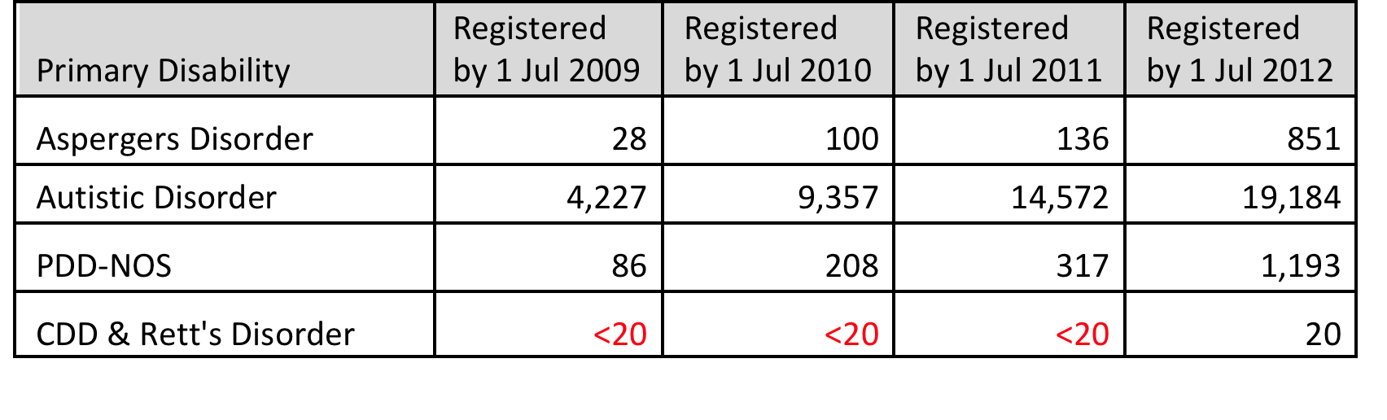
Helping Children with Autism
Very low Asperger’s Disorder under age 7 years, there are more PDD-NOS in this age range
CDD & Rett’s Disorder remain “rare”
Big jump in Asperger’s and PDD-NOS from 2011 to 2012?

Slide 13
Australian Bureau of Statistics (ABS)
Survey of Disability, Ageing and Carers (SDAC)
2009 survey: 63,500 households (self-reporting when possible); 9,500 establishments (information from staff)
Surveys all disabilities
Data collected in 1998, 2003 and 2009 …
Data used widely, e.g. in modeling for NDIS, burden of disease and injury, …
Autism/ASD is not a category in standard SDAC reporting
Specific report on autism from 2009 data
(1998 and 2003 autism data in 2004 proceedings)

Slide 14
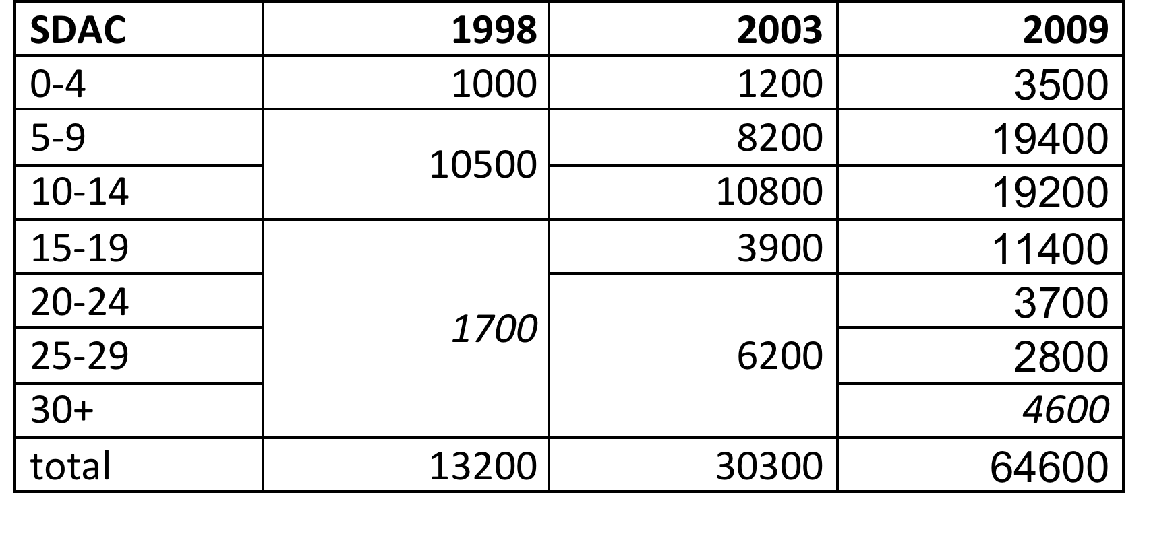
ABS SDAC 1998-2009

Slide 15
SDAC autism report
More than counting numbers …
Severe and profound disability
  2003: 87% with severe or profound disability
  2009: 74% with severe or profound disability
  So … some increase is milder cases (13%), but
  most growth is people with severe & profound disability
Abysmal outcomes for PwASD in education, labour force participation, disability services, … check it out
http://www.abs.gov.au/ausstats/abs@.nsf/mf/4428.0
Notes:
Some growth is milder cases … but most growth is severe & profound disability … consistent with reports in Nature.
How could these cases be missed
Not much evidence of “diagnostic substitution”, that is transfer fro other diagnoses

Slide 16
Compare 2009 data

Slide 17
conclusions
Autism prevalence estimates vary by age and time: we cannot
  assume uniform prevalence
  say “with a prevalence rate of 62.5 per 10,000 there could be as many as 125,000 people with ASD in Australia ...”
substantial growth in PwASD registering for services
ASD growth is mostly people with “severe or profound disability” (from measures of disability generally )
ABS reports abysmal outcomes for PwASD: Australia must do better for PwASD
different sources tell a remarkably consistent story
more analyses and more datasets (e.g. CSTDA/NDA datasets, Medicare items, …) can extend understanding of PwASD

Slide 18
Acknowledgements
ABS for providing unpublished data on autism
FaHCSIA
A4 Management Group
SOfASD in the ACT
AABASD Directors
Colleagues at JCSMR ANU

Slide 19
Thank you
for your interest

